Slide 1
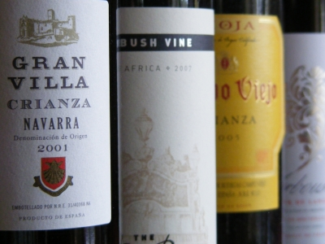
Usa WINE LABELING REGULATIONS
Katja Loeffelholz
Dickenson, Peatman & Fogarty
1455 First Street, Ste. 301
Napa, California 94559
(707) 252-7122
kl@dpf-law.com
February 26, 2018

Slide 2
DISCLAIMER
This presentation is provided by Dickenson, Peatman & Fogarty for educational and informational purposes only and is not intended and should not be construed as legal advice.

Slide 3
Concurrent Federal & State Power
Federal Power
State Power
Commerce Clause grants Congress the power to regulate commerce "among the several states."
General Police Powers re health and welfare.
21st Amendment; “The transportation or importation into any State, Territory, or possession of the United States for delivery or use therein of intoxicating liquors, in violation of the laws thereof, is hereby prohibited.”

Slide 4
Goal of Labeling Regulations
Federal Rules
Prevent consumer deception.
Provide consumers with adequate (and meaningful?) information as to the identity and quality of the product.
State Rules
Prevent consumer deception.
Provide consumers with adequate (and meaningful?) information as to the identity and quality of the product.
Protect / Promote reputation of local regions / wine industry.

Slide 5
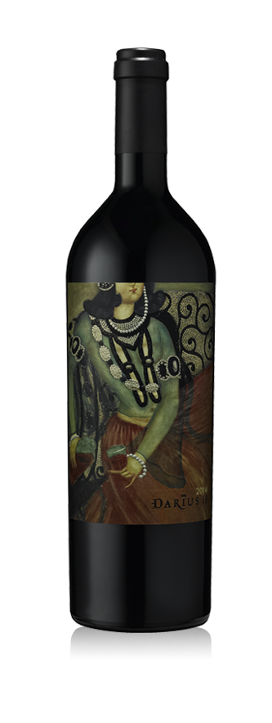
Which one is the “Brand Label”?
This… or This?

Slide 6
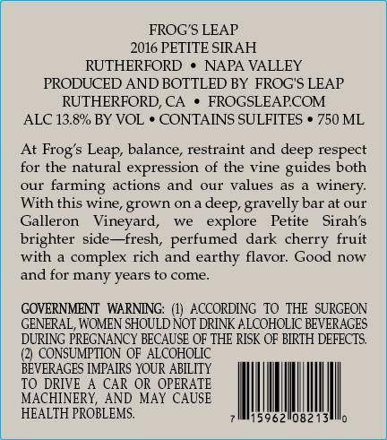
Alcohol Tobacco Tax and Trade Bureau (“TTB”): Label Information
Must Be on
“Brand Label”
Must Be on
the Bottle
Mandatory
Brand Name (Trademark)
Class / Type
If Varietal is used as Class/Type, then Appellation is required.
Bottler’s Name/ Address
Alcohol Content
Net Content
Health Warning Statement
Sulfite Declaration

Slide 7
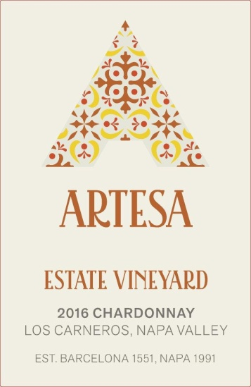
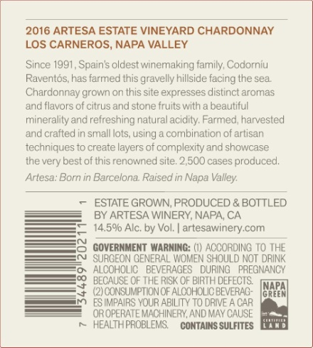
Alcohol Tobacco Tax and Trade Bureau (“TTB”): Label Information (continued)
Must Be on
“Brand Label”
Must Be on
the Bottle
Optional
Appellation
Fanciful Name (Trademark)
Vintage
Estate Bottled
Vineyard Designation (Trademark)

Slide 8
Which one is the “Brand Label”?
“Brand Label” is the one that contains the following information:
Brand Name (Trademark)
Class / Type of Wine
Appellation (if used)
Required if Grape Varietal is used as class / type
Previously, ABV had to appear on brand label. Now can appear anywhere.

Slide 9
Components of a wine label: Mandatory and Additional Information
Circled component = Required components of wine labeling

Slide 10
Mandatory
Information

Slide 11
1. Brand Name
Name under which the product will be sold.
Must appear on the “Brand Label.”
If there is no brand name, bottler’s name is treated as the brand name and, therefore, name/address of bottler must be on the brand label.
May not create a misleading impression.
Should be trademarked.
27 CFR 4.33

Slide 12
What is a Trademark?
Any symbol (word, image, configuration, sound, smell) used in commerce to designate source of a good or service.

Slide 13
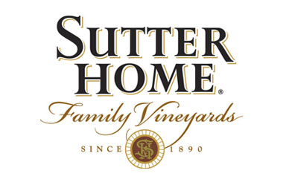
What is a Trademark?
Word – Brand Name
SUTTER HOME

Slide 14
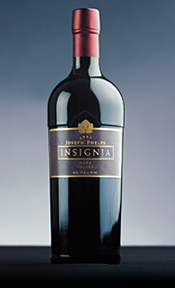
What is a Trademark?
Word – Fanciful Name
INSIGNIA

Slide 15
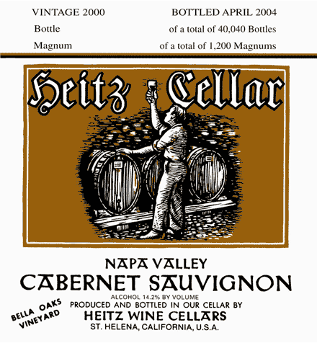
What is a Trademark?
Word
Vineyard Designation
BELLA OAKS
VINEYARD

Slide 16
What is a Trademark?
Word – Tagline

Slide 17
What is a Trademark?
Design: Logo

Slide 18
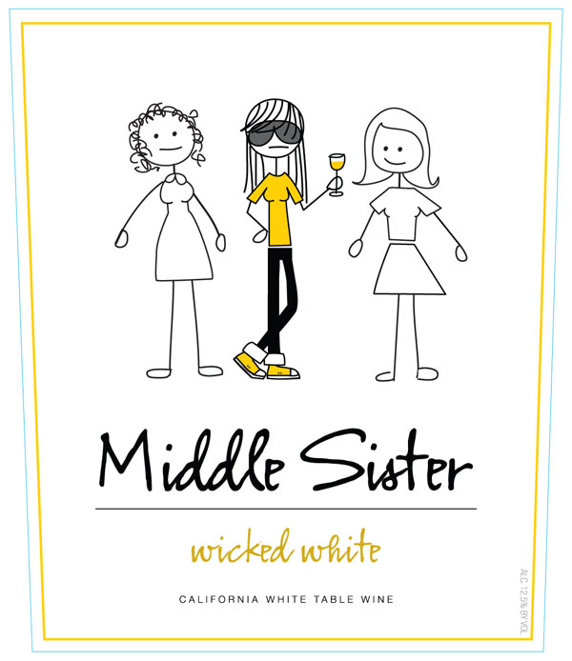
What is a Trademark?
Design: Label Design

Slide 19
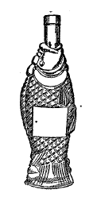
What is a Trademark?
Configuration: Bottle Shape

Slide 20
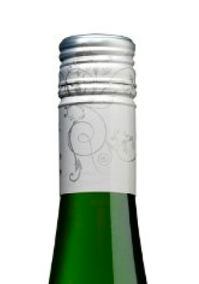
What is a Trademark?
Product Feature: Vine Design on Capsule

Slide 21
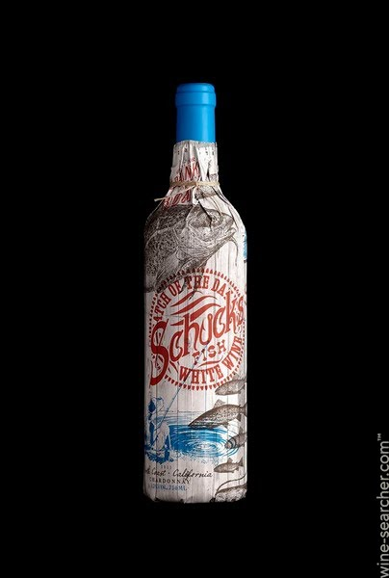
What is a Trademark?
Configuration
Overall
“Trade Dress”

Slide 22
Adoption of Marks
Self-Help “Knock-Out” Searching
Google
USPTO TEAS Database
TTB COLA Database

Slide 23
Registration of Marks
State
Federal
International

Slide 24
COLA Protection?
A COLA DOES NOT PROVIDE ANY RIGHT TO USE A MARK!!!
The application for a COLA expressly states that a COLA does not confer any trademark protection

Slide 25
2. Class / Type
Nine “Classes” / Standards of Identity:
Grape wine, which includes
Table Wine (no more than 14% ABV) (includes Light Wine, Red Table Wine, Light White Wine, etc.)
Dessert Wine (over 14%, but less than 24% ABV)
Sparkling grape wine
Carbonated grape wine
Citrus wine
Fruit wine
Wine from other agricultural products
Aperitif wine
Imitation and substandard or other than standard wine
Retsina wine **
27 CFR 4.21

Slide 26
2. Class / Type
Use of Grape Variety Names
One or more grape varieties can be used as the “type” designation for grape wine only BUT THEN wine must also be labeled with an Appellation of Origin “in direct conjunction” with the type designation and name of grape variety name has been approved by TTB (listed in 27 CFR 4.91)
Single variety designation may be used if 75% of content is from stated variety
More than one variety, but percentages must be included and percentages must equal 100%.
27 CFR 4.23, 4.34

Slide 27
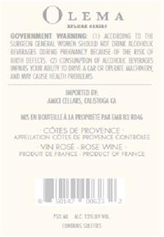
3. Bottler’s Name and Address
Bottler Name / Address
Name or trade name (DBA) of bottler as listed on the permit
Address (City and State) of bottler as listed on the permit
“Bottled by” or “Packed by”
27 CFR 4.35

Slide 28
3. Bottler’s Name and Address
Bottler Name / Address
Additional optional statements :
“Produced” / “Made” by – at least 75% of the wine was fermented at the stated location or changed the class/type or produced sparkling wine by secondary fermentation at stated address
“Blended” by – wine was blended / mixed with other wine of the same class and type at stated location
“Cellared” / “Vinted” / “Prepared” by – wine was treated at the stated location prior to bottling.
27 CFR 4.35

Slide 29
4. Alcohol Content
All wines must have a statement regarding alcohol content.
Typically, stated as “Alcohol __% by Volume.”
Tolerance of 1.5% if 14% or less, 1.0% if above 14%
Can also use a range
3% range if 14% or less, 2.0% if above 14%
Option for wines of 14% ABV or less: Can simply rely on type designation if labeled as “Table Wine”
Note on tolerance / ranges: make sure you are in the right tax class
27 CFR 4.36

Slide 30
5. Net Content
Must be in line with standards of fill.
50ml, 100ml, 187 ml, 375ml, 750ml,
If less than one liter, then stated in ml (375ml, 750ml)
If one liter or more, then stated in liters, and decimals thereof (1L, 1.5L, 3L)
Above 3L – then standards are full numbered liters (4L, 5L, etc).
27 CFR 4.37, 4.72

Slide 31
6. Health Warning / Sulfite Declaration
Health Warning
Sulfite Declaration
Health Warning
Specific wording set forth in federal regs.
Specific type, font size, other requirements
Sulfite Declaration
Necessary if 10 parts per million or more
If less than 10ppm, lab analysis needed to omit declaration from label
27 CFR Part 16
27 CFR 4.32(e)

Slide 32
Optional
Information

Slide 33
Additional Label Information
Must be truthful, accurate, specific and not misleading
May not conflict with or qualify mandatory information
Must comply with the corresponding sections of the regulations
Statements must be substantiated by production records
27 CFR 4.38(f)

Slide 34
Fanciful Name

Slide 35
Vineyard Designation
95% was produced from material grown on the named vineyard.
No requirement that a vineyard designated wine also be labeled with an appellation of origin.
Should be trademarked.
27 CFR 4.39(m)

Slide 36
Estate Bottled
NOTE: must be labeled with an AVA name (not just any appellation)
Bottling winery must:
Be in the labeled AVA
100% of the grapes grown on land “owned or controlled” by bottling winery within the boundaries of the labeled AVA
“property on which the bottling winery has the legal right to perform, and does perform, all of the acts common to viticulture under the terms of a lease or similar agreement .” Question: what about grape purchase agreement?
Produce and bottle all the wine in a continuous process, the wine never leaving the bottling winery’s premises.
27 CFR 4.26

Slide 37
THANK YOU!

